Slide 1


Introducing R and the RStudio IDE
Alana Schick, IMC Bioinformatics, University of Calgary
a.schick@ucalgary.ca, @alana_schick

Slide 2

What is R?
R (since 1995) is a programming language developed to teach statistics
R is open source (ie. free), widely used, flexible, and powerful

Slide 3
Packages for everything
car – car's Anova function is popular for making type II and type III Anova tables
mgcv – Generalized Additive Models
lme4/nlme – Linear and non-linear mixed effects models
randomForest – Random forest methods from machine learning
multcomp – Tools for multiple comparison testing
vcd – Visualization tools and tests for categorical data
glmnet – Lasso and elastic-net regression methods with cross validation
survival – Tools for survival analysis
caret – Tools for training regression and classification models
https://support.rstudio.com/hc/en-us/articles/201057987-Quick-list-of-useful-R-packages

Slide 4

Packages for everything
> install.packages("meme")
> library(meme)
> meme(img, "data science", "so hot right now")

Slide 5

What is R? What is RStudio?
R (since 1995) is a programming language developed to teach statistics
R is open source (ie. free), widely used, flexible, and powerful
RStudio is an Integrated Development Environment (IDE) that allows users to run R in a more user-friendly way

Slide 6
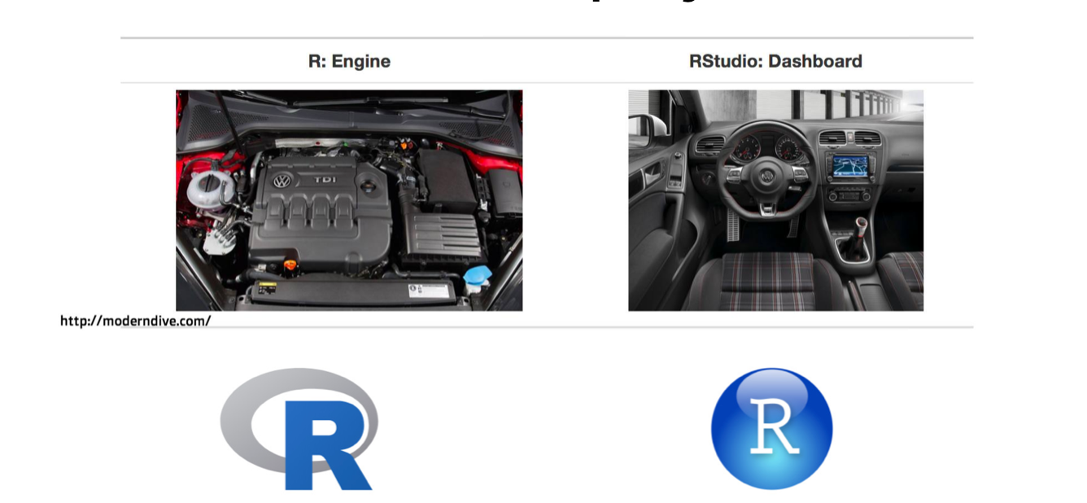
What is R? What is RStudio?

Slide 7
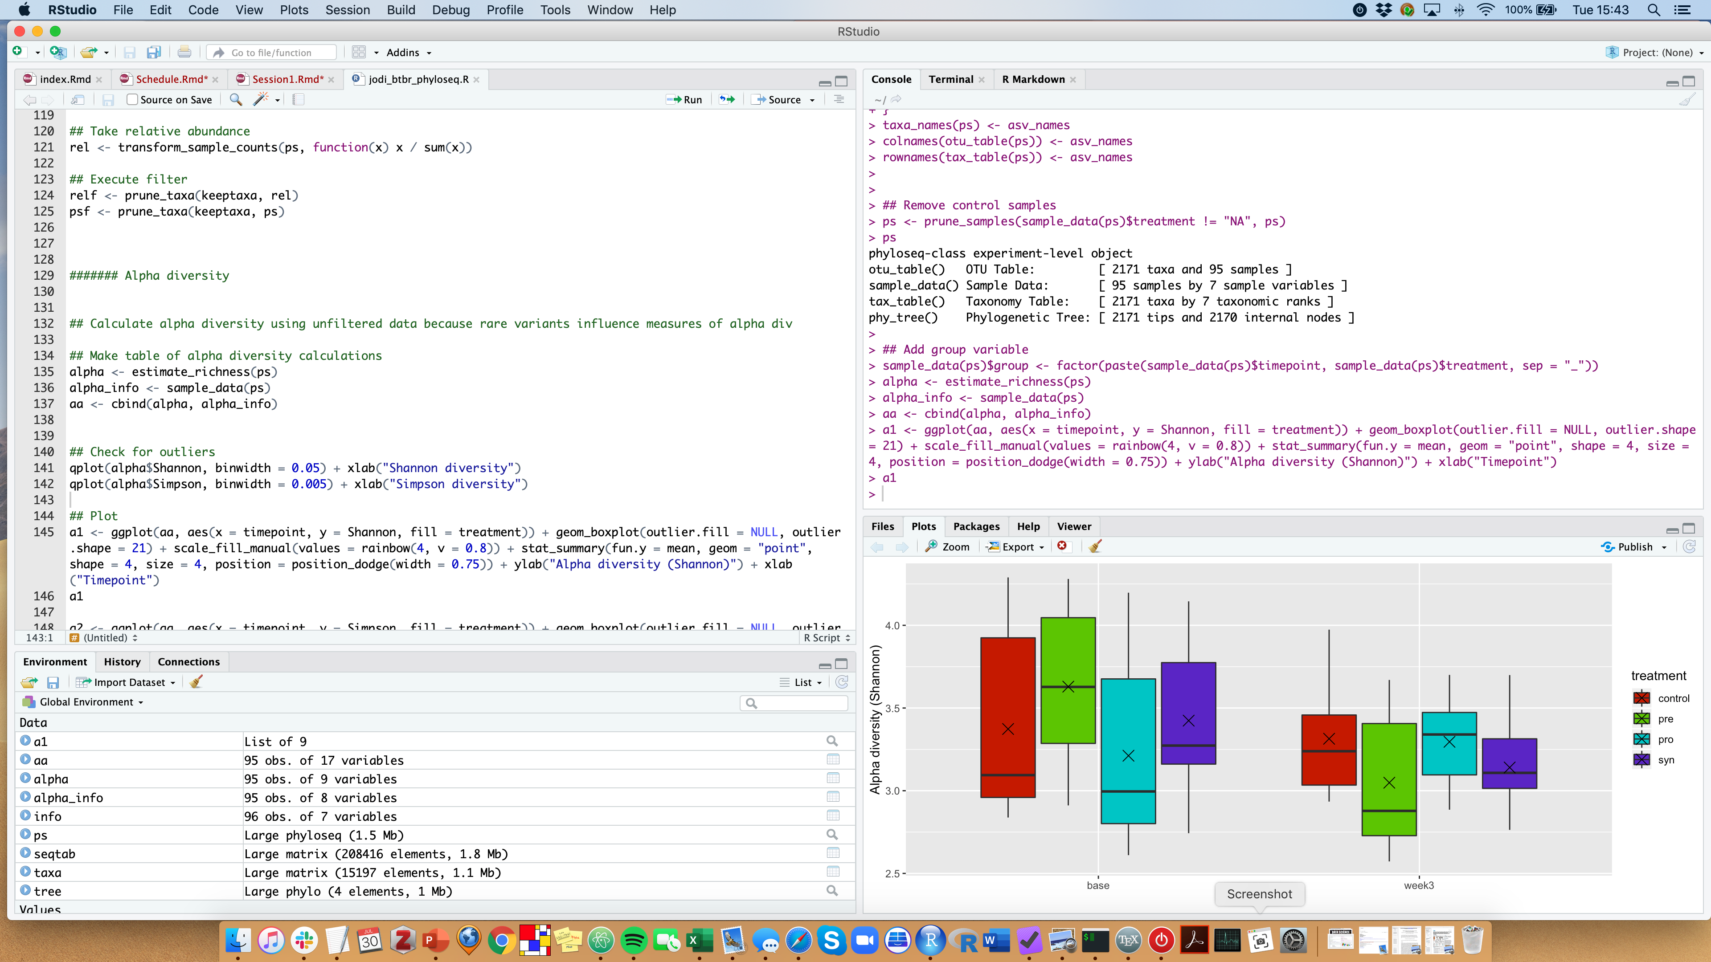
RStudio looks like this

Slide 8
RStudio screen
Console
Script
Plots
Environment

Slide 9
RStudio screen
Console
Script
Plots
Environment

Slide 10
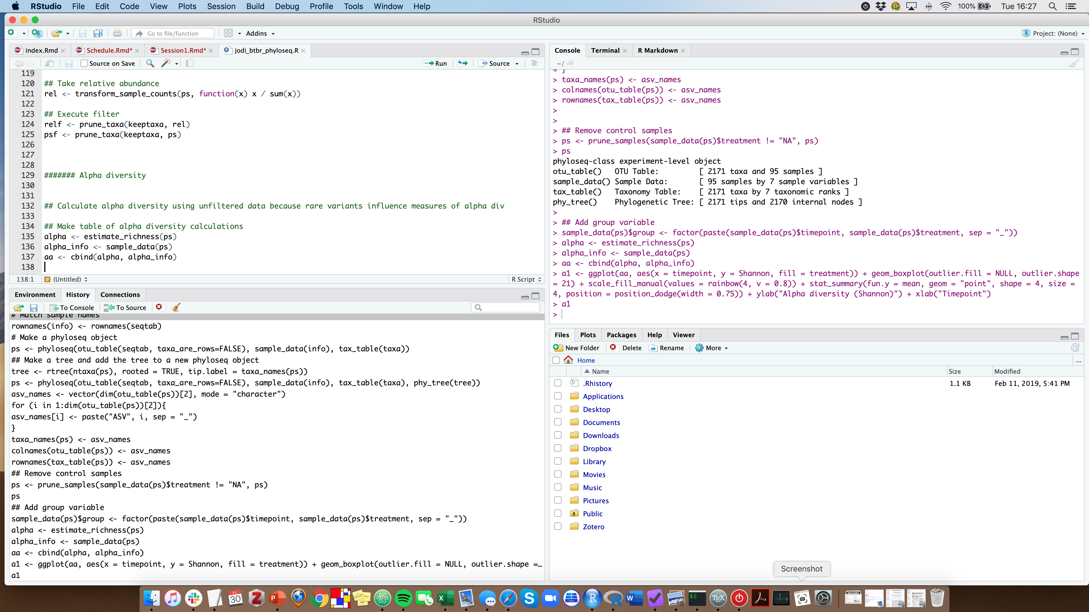
RStudio screen
Console
Script
History
Files

Slide 11
How to R – 2 ways
Console
Script
1. Typing and executing commands interactively here.
2. Using and saving scripts (ie. plain text files of code).

Slide 12

How to R – 2 ways
Console
Script
1. Typing and executing commands interactively here.
2. Using and saving scripts (ie. plain text files of code).
Choose this one.

Slide 13
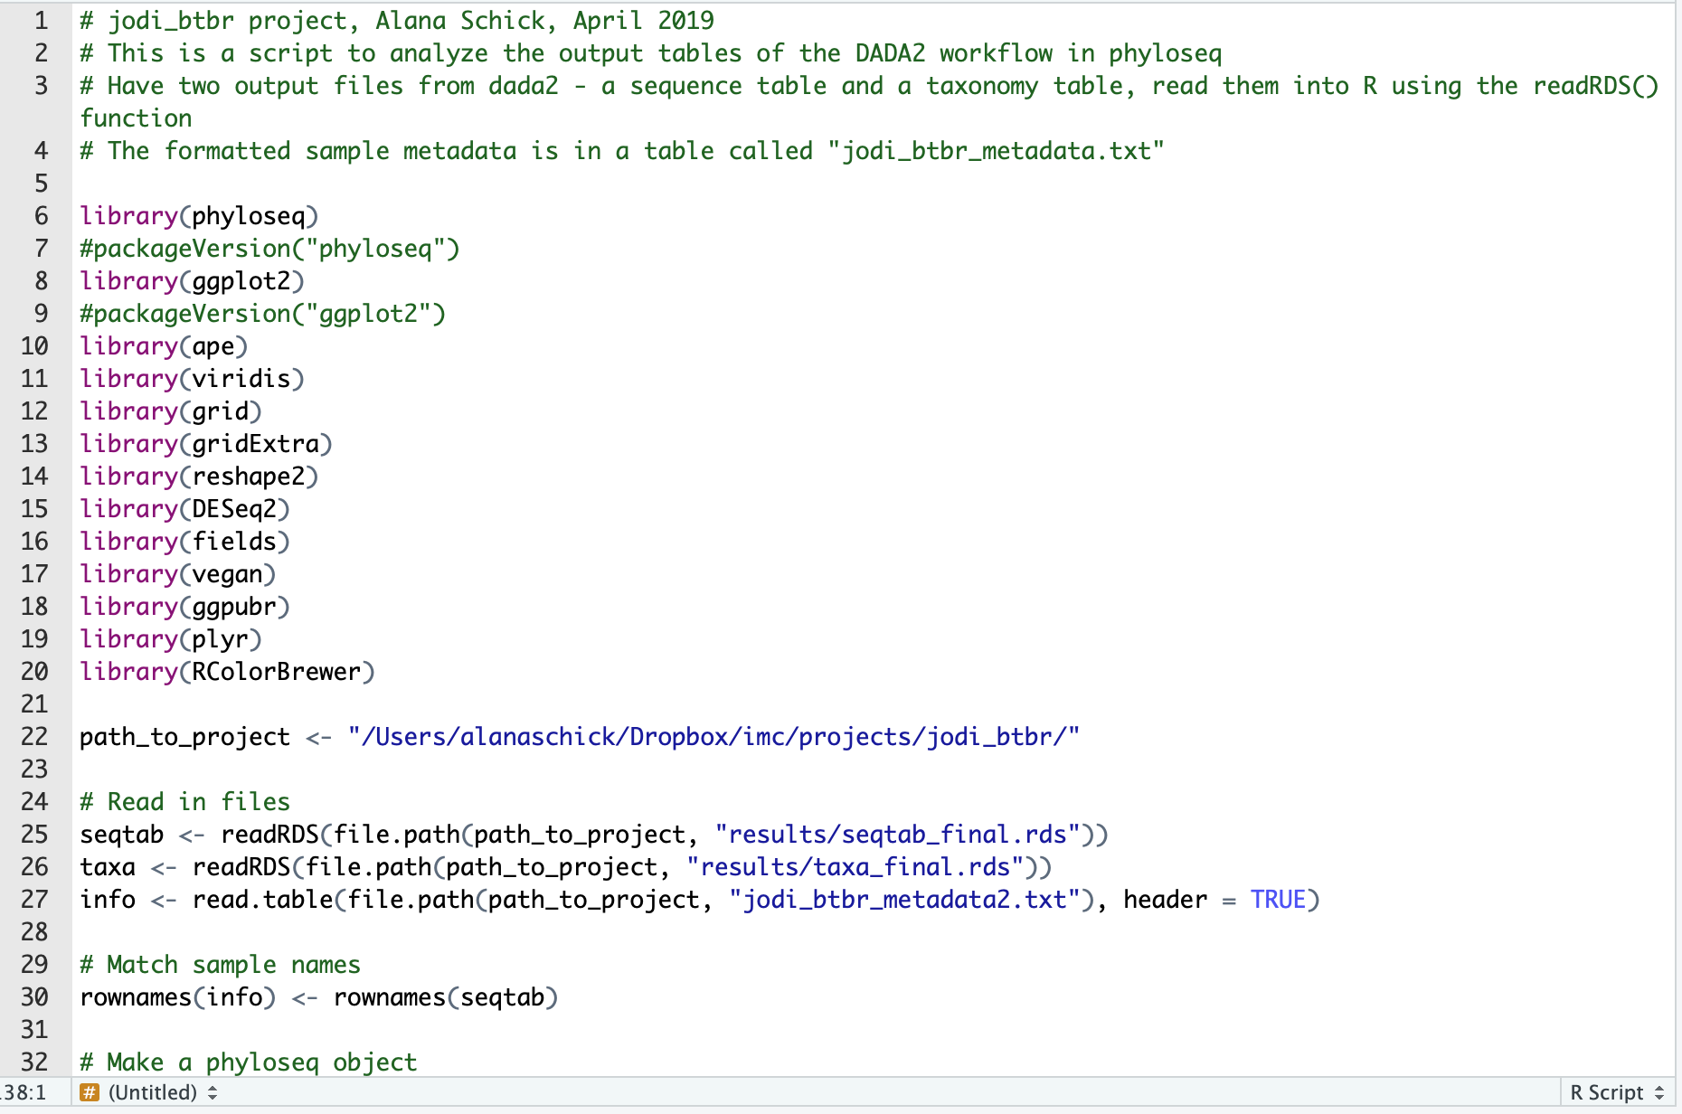
Scripts
Everything in the console will be forgotten when you close the session.
Scripts are saved, keeping a complete record of the commands you ran so you can run them again (ie. completely reproducible).
Can execute parts of this or the entire script.

Slide 14


Scripts - commenting
Comment out lines of your scripts by using the # symbol. R will not run these.
Be descriptive. You will not remember what you did a year later.

Slide 15

Packages
Packages are collections of R functions developed for a specific task.
Packages need to first be installed on your computer.
After installed, library() is the command used to load a package.

Slide 16
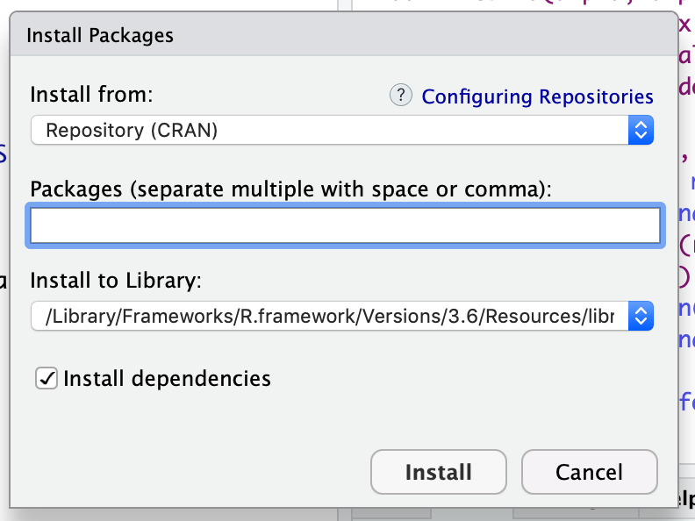
Packages
Tools > Install packages...

Slide 17
Working directory
Every time you open RStudio, it goes to a default directory, usually your home directory.
You can use the command setwd() to change the working directory.
setwd("home/aschick/projects/workshop")

Slide 18
Working directory
However: you may want to run your script on a different computer with a different directory structure where that directory does not exist.
Or you may want to work in multiple directories.

Slide 19
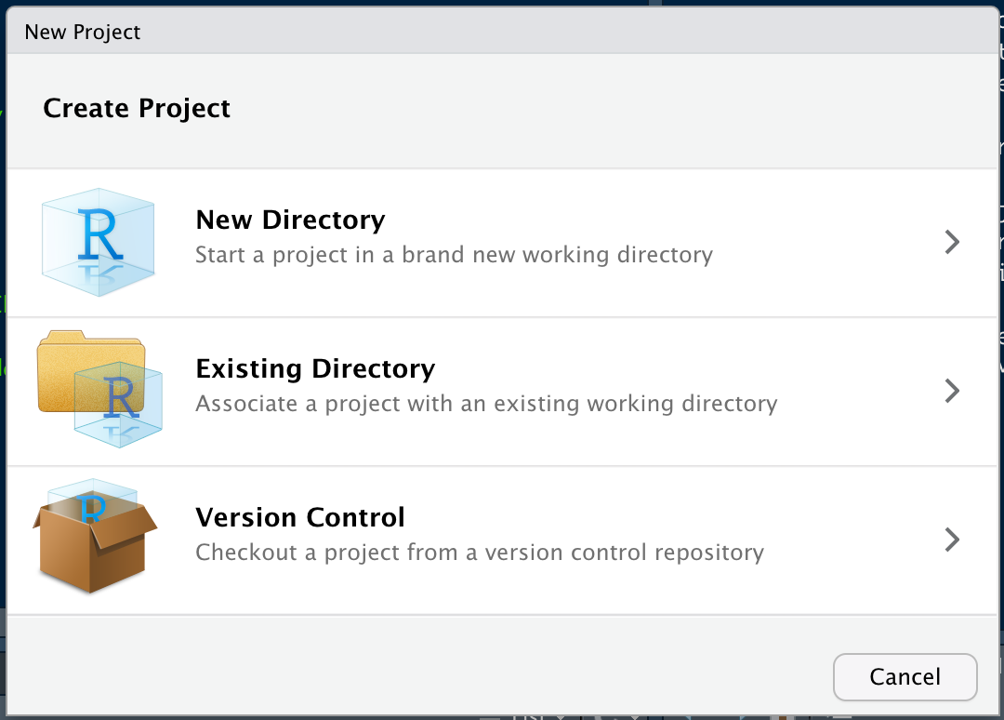
RStudio Project
File > New Project...
Clicking on New Directory will create an RStudio Project.
This directory will have all the data, files, plots, etc. for that project as well as a .Rprog file.

Slide 20
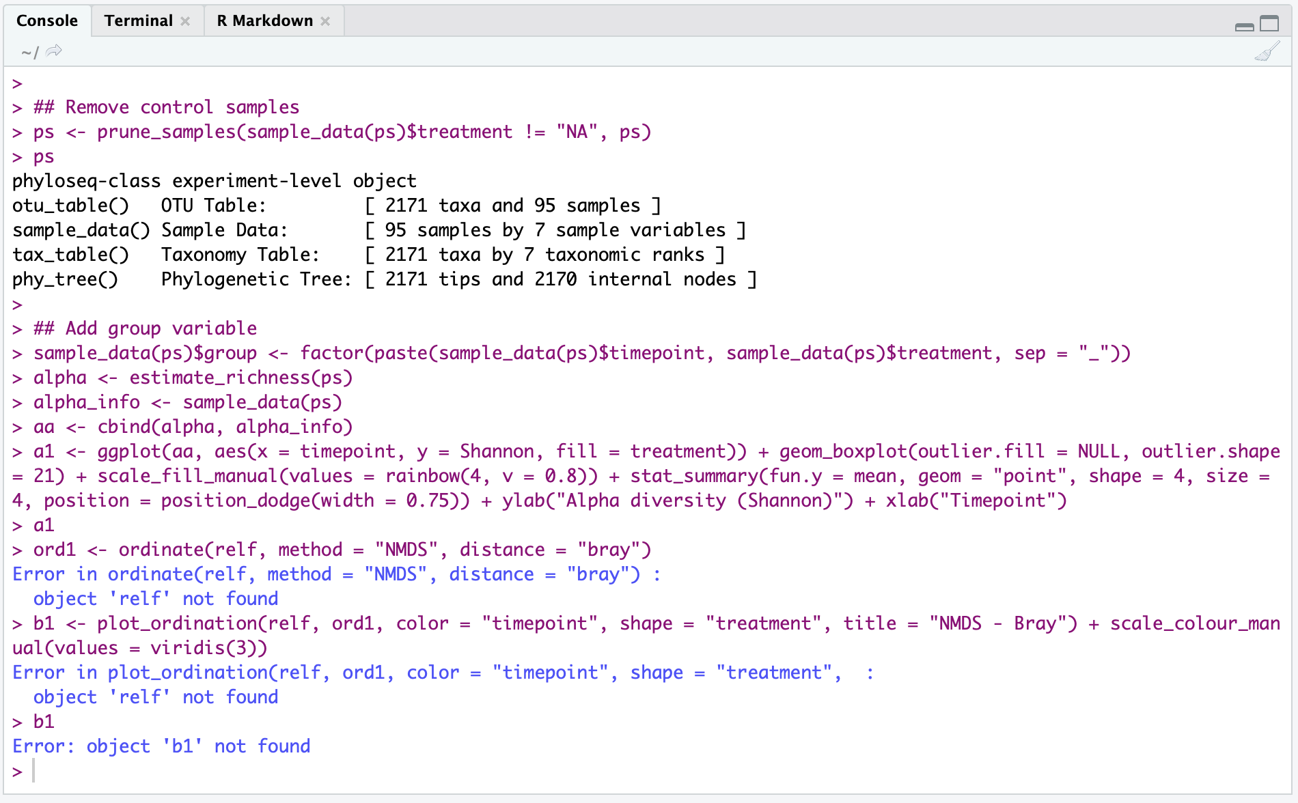
Error messages

Slide 21

Error messages

Slide 22
Getting help
Search in Help tab

Slide 23
Getting help
Search in Help tab
Type ? followed by the function name in the console (or ?? for installed packages)
> ?barplot
> ??geom_point

Slide 24
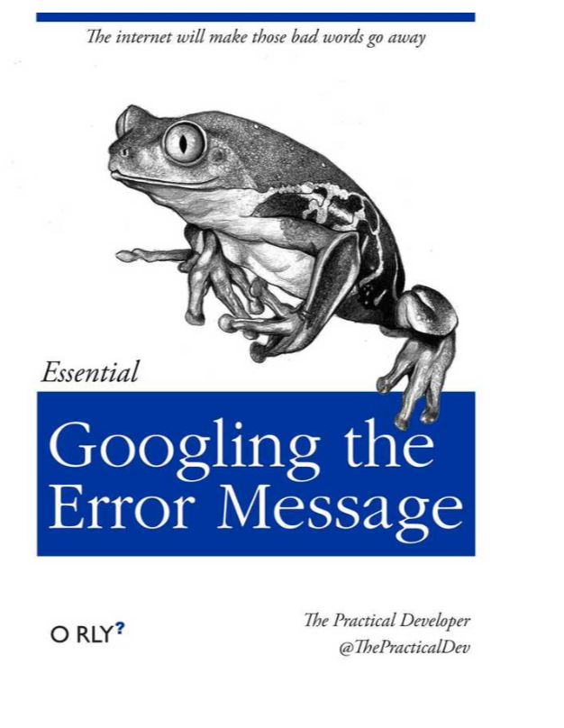
Getting help
Search in Help tab
Type ? followed by the function name in the console (or ?? for installed packages)
Google the error message
See website for tips and resources!

Slide 25
Summary and best practices
Always save your code in R scripts
Load packages using library() at the top of your script
Write clear, readable code with comments*
Be mindful of your working directory or location of files
Use RStudio projects to organize scripts, data, and output
*See http://adv-r.had.co.nz/Style.html for tips.

